Slide 1

Gender & Leadership in Obstetrics & Gynaecology
Master of Clinical Education Presentation
Dr Kirsten Connan
Obstetrician/Gynaecologist
Notes:
Hi my name is Dr Kirsten Connan and I’m an obstetrician and gynaecologist – daughters call me – a vaginacologist!
My Masters project is on ‘gender and leadership in O&G’ – it is project that I anticipate will be actionable within my own specialty, but I hope also in the wider field of medicine.

Slide 2
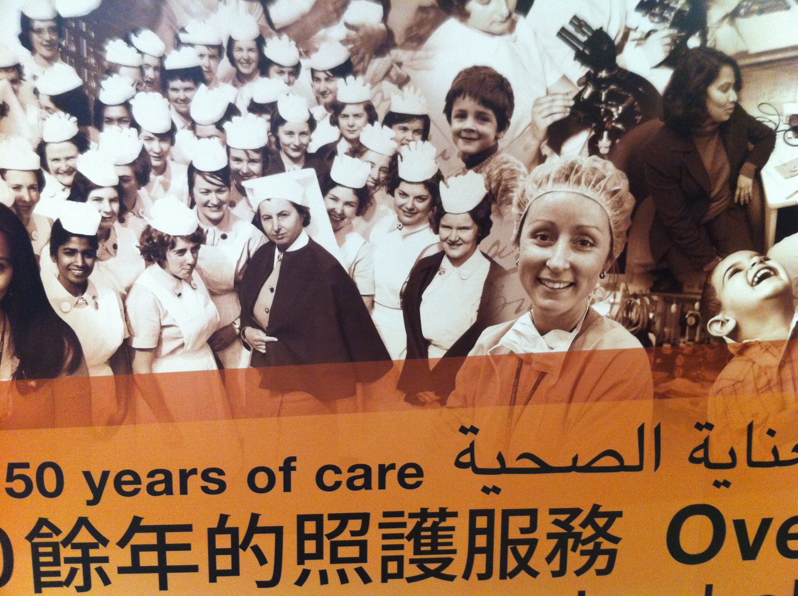
Notes:
Start by acknowledging MY personal bias
I am a feministic. I believe in equality for all
I am the dominant gender & ethnicity in my medical specialty
I hold a position of leadership in my industry
I didn’t recognize gender bias in my specialty during training. Now I see it regularly
I hold my own gender bias – some explicit and some that I know doubt don’t even know
I believe gender biases can contribute to gender leadership inequality
I believe that my college has a gender leadership gap that should be addressed
All this leads me to the WHY of this research
- I wanted to know what the gender leadership looked like in O&G, and what members within the specialty though about leadership, gender biases and the use of gender quotas.

Slide 3


Gender & Leadership in Obstetrics & Gynaecology (O&G)
PRIMARY (Institutional)
Is there gender equity of leadership within O&G training institutions in Australia & New Zealand?
SECONDARY (Membership)
What current leadership positions to members hold?
Does desire for leadership differ between genders?
Have members experienced gender bias?
Should RANZCOG consider gender quotas?
Notes:
The primary question I’m seeking to answers with my Master project is = READ
Institutions – RANZCOG, all RANZCOG affiliated hospitals (98), and all universities in Australia and New Zealand with an O&G department (20)
My secondary questions focus on the specialist and trainee members of the college, both men and women, and their experience of gender equity
There are many models of leadership that educational theorist have proposed – most of these have been based on attributes, behaviors, actions and outcomes. (like great man, trait, transactional or transformation theory)
Within medicine – leadership is more commonly based on authority roles – that’s what I’ve chosen to define ‘leadership as
The authority roles within O&G include the
RANZCOG presidency
The National board & council
Head of University and hospital departments

Slide 4

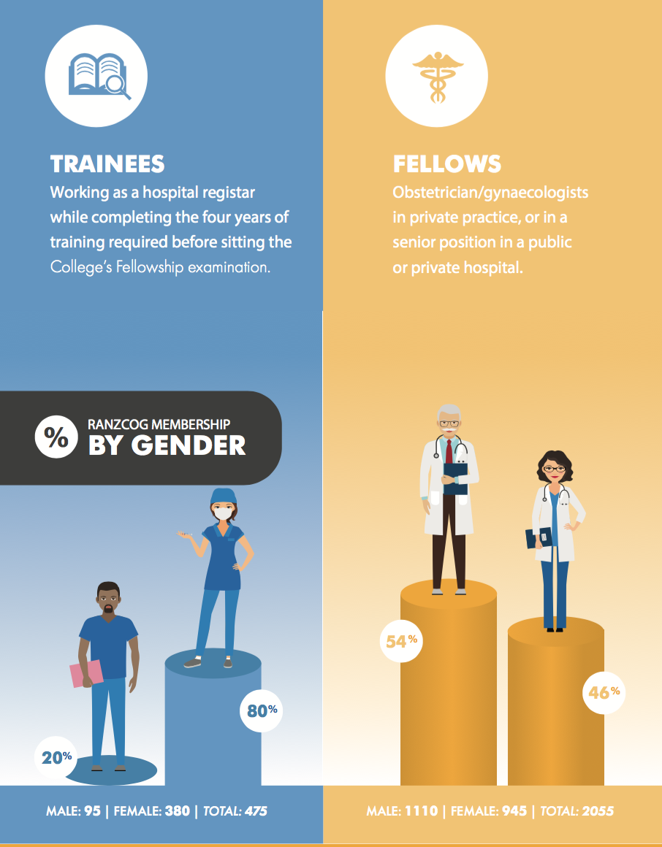
Vision – Excellence in women’s health. To be the leading authority in women’s health in Australia and New Zealand.
Mission – Through education and training, advocacy and policy development we influence he standard of care delivered in our community.
Notes:
RANZCOG – training and accreditation body for obstetrician's and gynaecologist in Australia and New Zealand
80% of trainees & 46% of specialists are female
RANZCOG – RCOG – independent college since 1998
Since that time - ONLY one female president (2006-2008) – 2 year term
AND the number of females in federal council, although increasing, has never increased beyond 30%
This is despite being an increasingly feminized with 805 of trainees now females and 46% of specialists being female
Many would advocate that equality is highly desirable in the leadership work space as a social justice issue
We also know gender equality in leadership strong association in many industries with improved financial revenue, gender cultural reform, and improved maternal and child health outcome – there all great outcomes for both industries and society
Trainees - (67% in 2009 – now 80% in 2017)
Specialists - (27.2% in 2005 --> 48% in 2017)

Slide 5
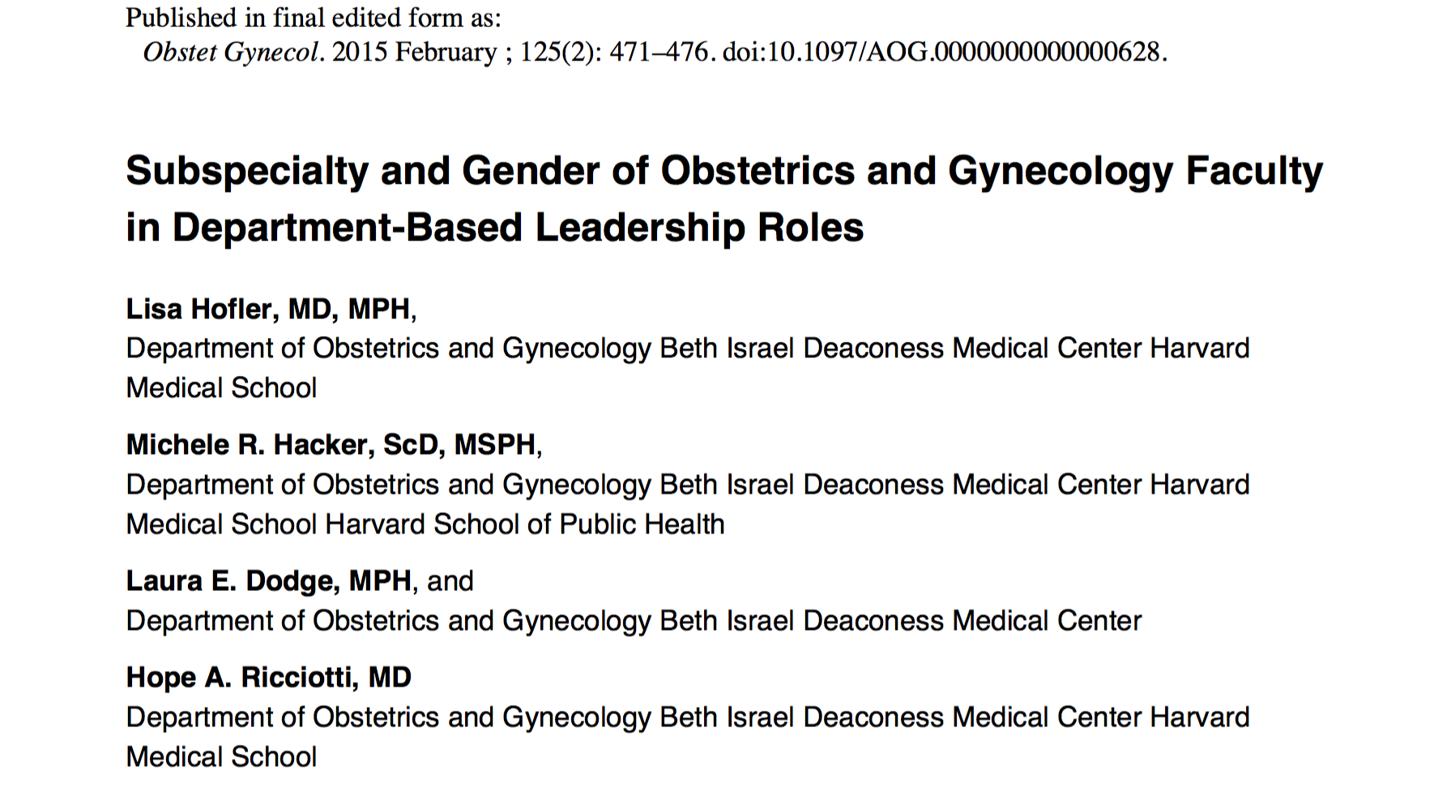
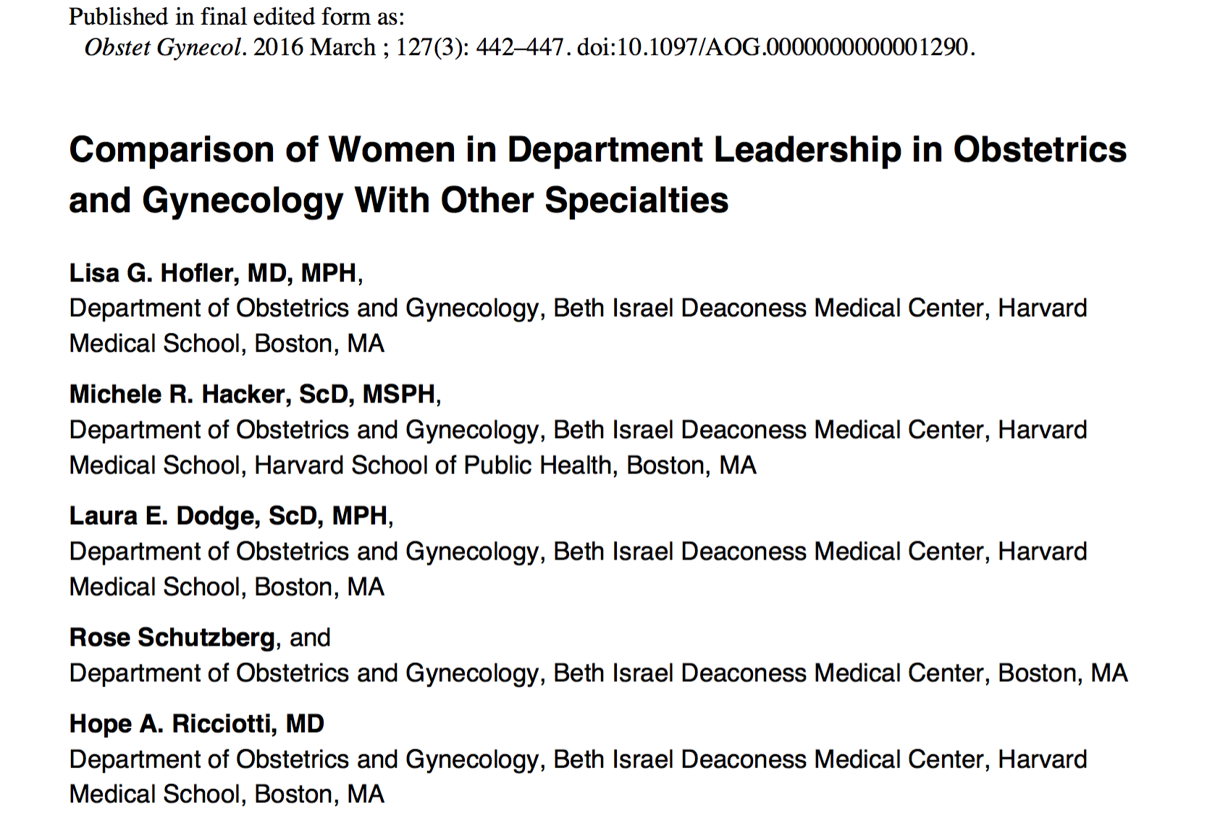
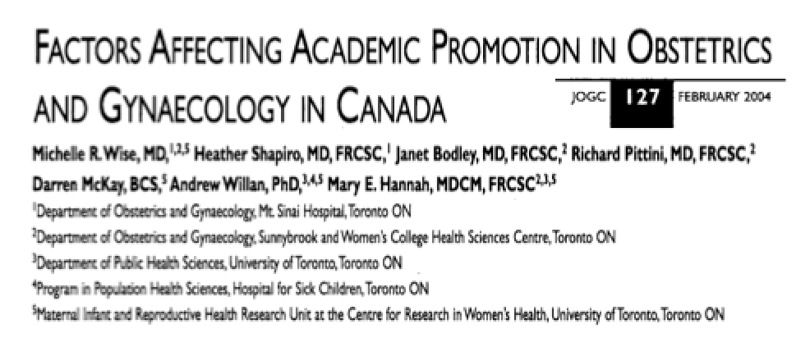
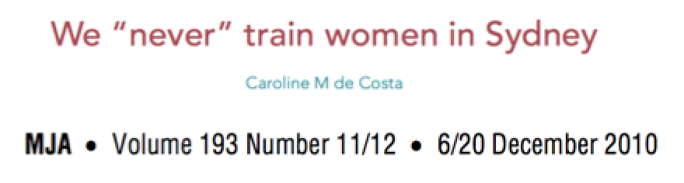
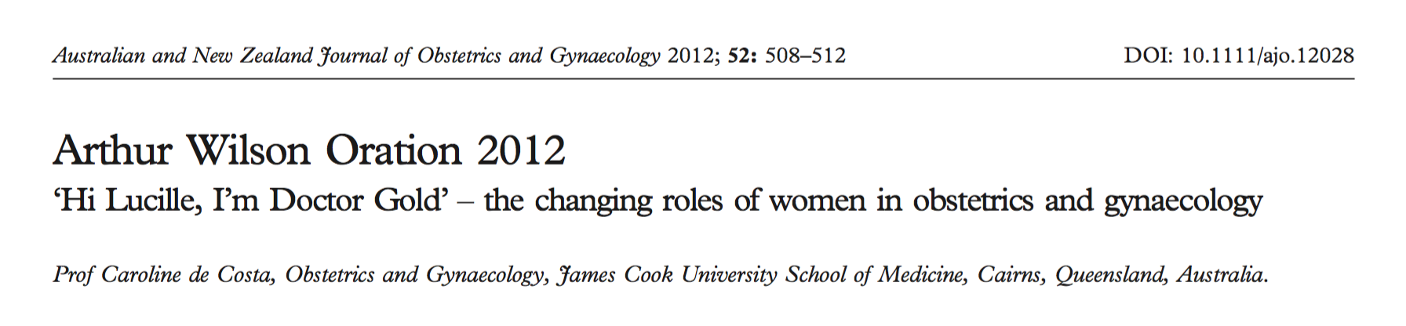
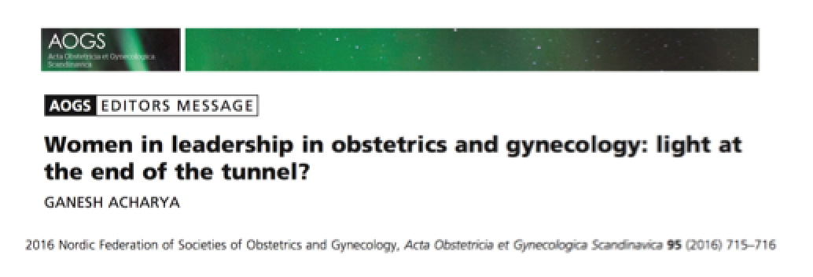
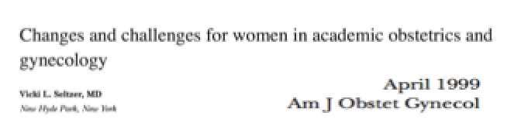
Notes:
There are very studies in the international and national literature that have reviewed gender and leadership within O&G
In fact this is all of them!
What is revealed form the literature on gender and leadership in O&G - is that women are consistently under represented
Those that do hold leadership positions - were more likely to hold their position if other women were already in similar leadership positions, and if they had received mentoring
Most of my reading has come from other areas of medicine and the healthcare industry more broadly
# 1 observational study in the US accredited teaching hospitals – women were under represented in leadership positions – of the leadership positions - more likely to be in hospital teaching/supervision leadership roles, not HOD departments roles
In the US Women have comprised more than 50% of obstetrics and gynecology residency graduates for over 20 years (6)
# 2 cross sectional observation study – compared number of women in leadership roles between O&G and other specialty departments across the US
Lower compared with other specialties and lower compared to intact in residency (of women) in 1990 to now (2013) – pipeline effect – not enough
# 3 Qualitative study – O&G departmental chairs at the 16 medical schools - survey on attitudes on gender and leadership and leadership promotion – 2003
1/3 females
Women more likely to perceive barriers to promotion
Mentorship

Slide 6
Methodology
Literature review.
Survey all trainees and fellows.
Access public documents for all:
  RANZCOG leadership positions.
  RANZCOG accredited hospitals in Australia & NZ.
  O&G university departments in Australia & NZ.
Data analysis.
Situate findings within the literature.

Slide 8
Notes:
Is there gender & leadership equity?
Nationally this doesn’t exist – beyond RANZCOG is the gender and leadership equity in other leadership domains?
Does desire for leadership differ between genders?
Cultural perception suggest that females are less ambition and desiring of leadership, but the literature indicate in other industries, this is NOT the case
Do members report gender bias and what type?
Implicit and explicit gender biases as well as structural barriers influence the gender leadership gap in other industries, including medicine as a while, is this similar in the sub speciality of O&G?
Is bias different among members? – between genders and between trainees and specialists?
Should RANZCOG consider gender quotas? This has been suggested as one of the ways to reduce the gender leadership gap and in areas such as politics and boards of ASX companies, this has reduced the gender leadership gap, as well as improved financial revenue and changed health outcomes for women and children

Slide 9
RANZCOG leadership positions
Notes:
These are my findings so far -
A snap shot – public data
Taken in JULY 2017 – specialist figures in Australia and New Zealand
RANZCOG president (2 year terms – 1998 – only one female president) = 0%
0% / 100%
RANZCOG federal board – 7 members – 1 female = 14%
RANZCOG federal council – 22 members – 7 females = 32%
National Chairs – 62 – 19 females - 31%
Educational
State T&A Chairs 7 members – 5 females – 71%
Hospital ITP program coordinators – 32 total – 17 females - 53%

Slide 10
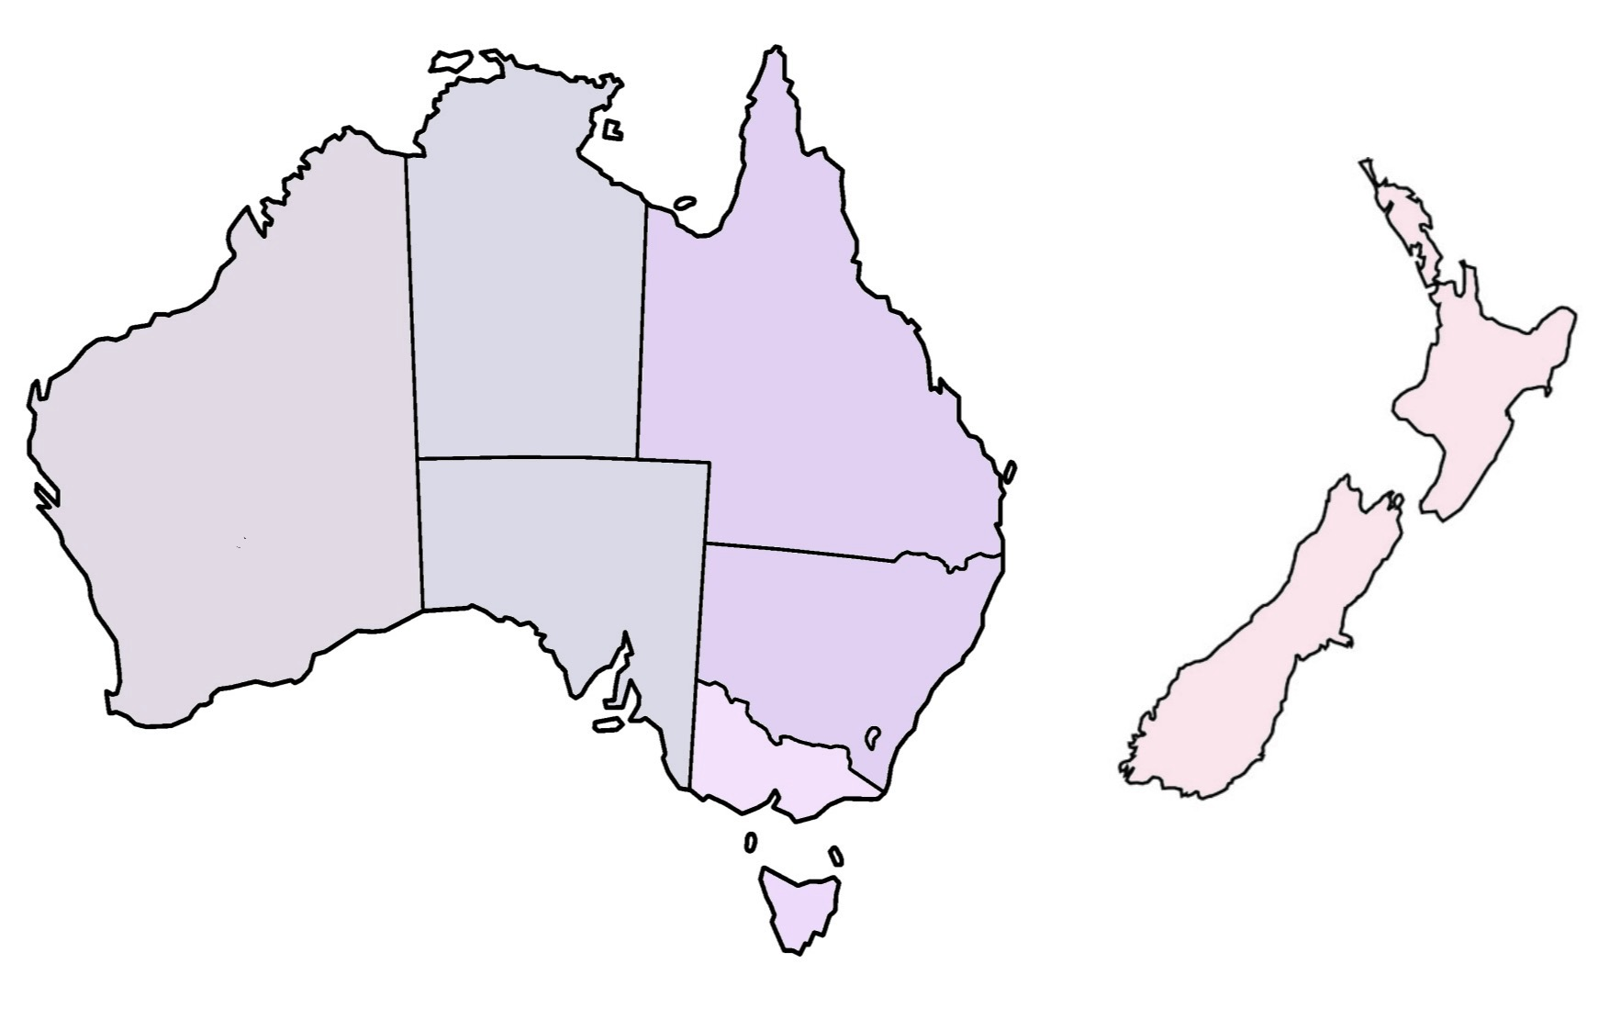
Accredited hospitals HOD
27%
21%
16%
27%
58%
33%
38%
33%
Notes:
State by state – hospital HOD/Units - Total = 31.5% (average) -
VIC 37.5% - 22 hospitals
TAS 33.3% - 3 hospitals
ACT 33.3% - 3 hospitals
NSW 27.3% - 25 hospitals
QLD 26.7% - 16 hospitals
WA 21% - 8 hospitals
SA/NT 16% - 9 hospitals
NZ 57.7% - 12 hospitals

Slide 11
University O&G
Department Head
Australia 33%
18 Universities
20 Heads of department
5 females (2 joint)
New Zealand 67%
2 Universities
3 Heads of department
2 females (1 joint)
Notes:
Head of the discipline O&G
TOTAL 30.5%

Slide 12
Final thoughts
Little past data available on Australian & New Zealand O&G gender and leadership.
Leadership gender in O&G is poorly representative of both trainees and specialists.
Survey currently underway, will provide some indication of reasons and remedy for imbalance.
Thank you!
Notes:
1. Unfortunately there is little past data on gender and leadership in O&G in Australia and New Zealand and that’s why this study is important. There are no records on the gender of trainees and specialists in Australia and New Zealand before 2009.
2. Already my preliminary findings highlight that there is a significant gender leadership imbalance in O&G in Australia and NZ and this is not representative of its members
3. I think the most interesting data for this project will come from my survey of the 2500 members of O&G, which after a long approval process, goes out tomorrow. Its will be interesting to see if whether members themselves report gender bias and whether they see value the action of introducing gender quotas.
Thank you!

Slide 13
Agenda
Landscape where are we at now?
Research what am I doing?
Findings what have I found so far?
Next steps where next?
Notes:
Over the next 2 minutes I’m going to take you on a brief journey on my masters to date –
Current landscape
What’s my project involves
What I’ve found so far
What comes next (you can find out about at the next presentation in October)!

