Slide 1

Gender & Leadership in Obstetrics & Gynaecology
Master of Clinical Education Presentation
Dr Kirsten Connan
MBBS(Hon) FRANZCOG DDU GradDip(Clin Teach)
Obstetrician/Gynaecologist
Notes:
Hi my name is Dr Kirsten Connan and I’m an obstetrician and gynaecologist – daughters call me – a vaginacologist!
My Masters project is on ‘gender and leadership in O&G’ – it is project that I anticipate will be actionable within my own specialty, but I hope also in the wider field of medicine.

Slide 2
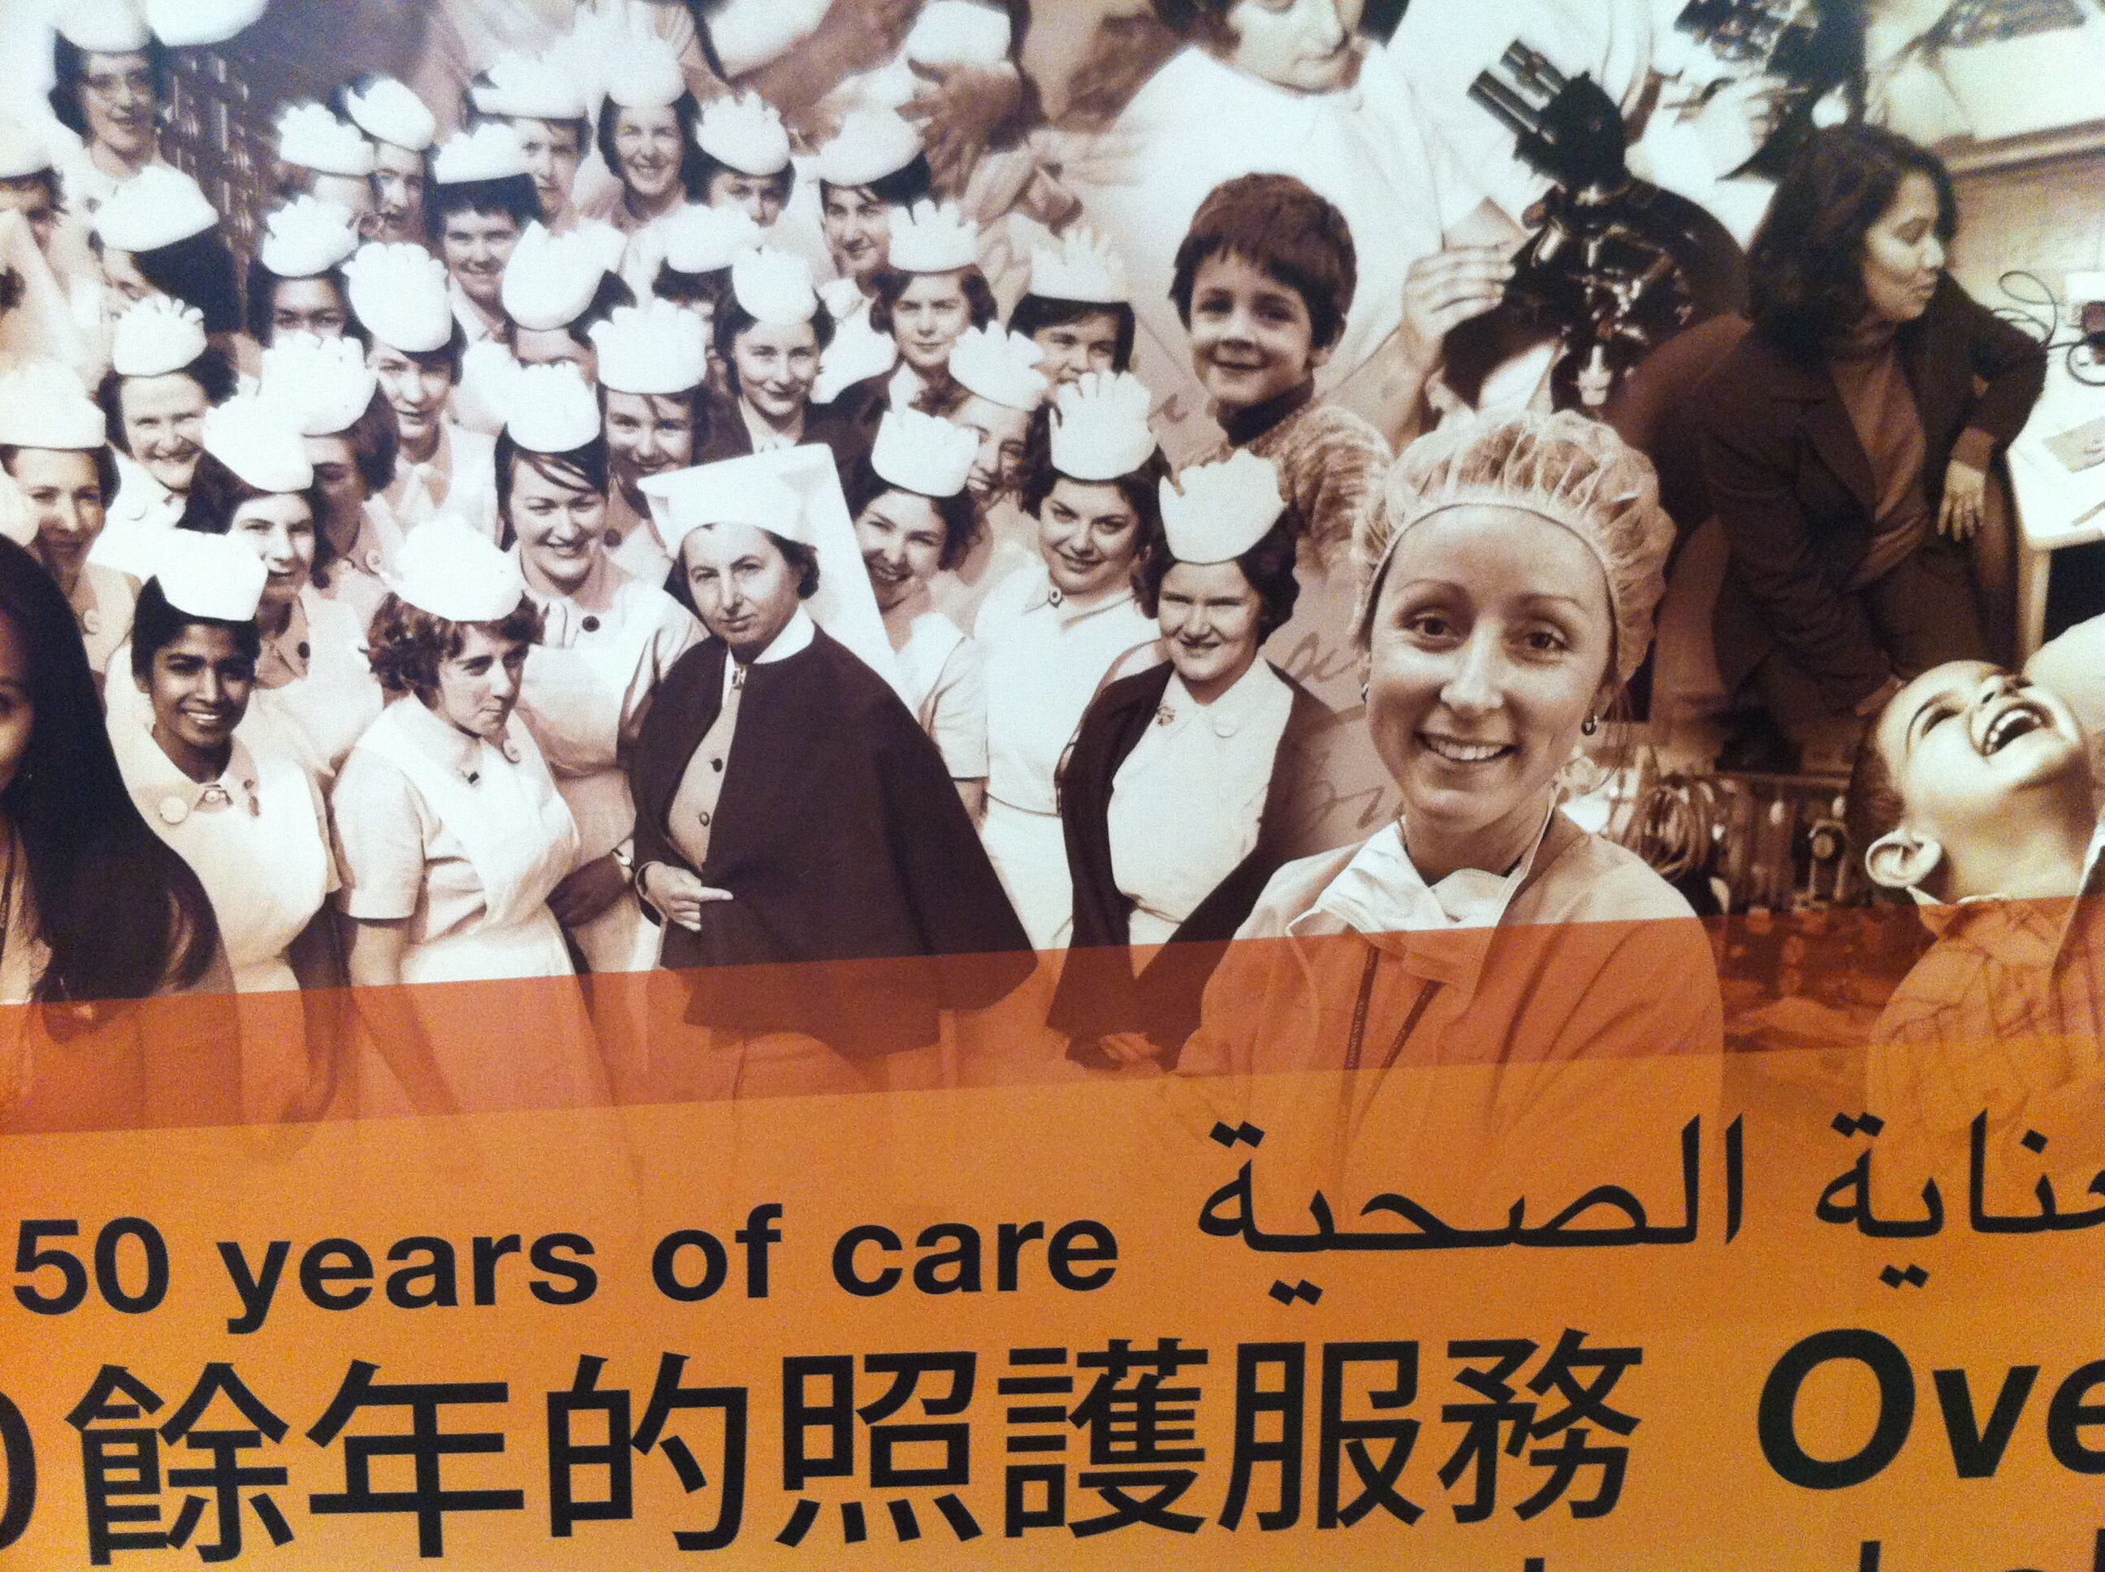
Notes:
Start by acknowledging MY bias
I am a feministic. I believe in equality for all
I am the dominant gender & ethnicity in my medical specialty
I have held positions of leadership in my college
I hold my own gender bias – some explicit and some that I’m sure I don’t even know
I believe gender biases can contribute to gender leadership inequality
I believe that my college has a gender leadership gap that could be addressed
All this leads me to the WHY of my research
I wanted to know what the gender leadership landscape looked like in O&G in Australia and New Zealand, and what members of my specialty thought about leadership, gender biases and the use of gender quotas.

Slide 3


Gender & Leadership in Obstetrics & Gynaecology (O&G)
PRIMARY (Institutional)
Is there gender equity of leadership within O&G training institutions in Australia & New Zealand?
SECONDARY (Membership)
What current leadership positions to members hold?
Does desire for leadership differ between genders?
Do barriers to leadership differ between genders?
Have members experienced gender bias?
Should RANZCOG consider gender quotas?
Notes:
This led me to my aims
- The primary question I was seeking to answers was = READ
- My secondary questions focused on members views and their experience of leadership, gender bias, and quotas use within our college.
….
There are many models of leadership that educational theorist have proposed – most of these have been based on attributes, behaviors, actions and outcomes. (like great man, trait, transactional, transformation theory and feminist leadership)
Within medicine – leadership is more commonly based on authority roles – that’s what I’ve chosen to define ‘leadership as
The leadership roles within O&G include the
RANZCOG presidency
The National board members, federal councilors, national committee chairs
RANZCOG ITP coordinators, T&A committee state chairs
Head of O&G university and hospital departments

Slide 4

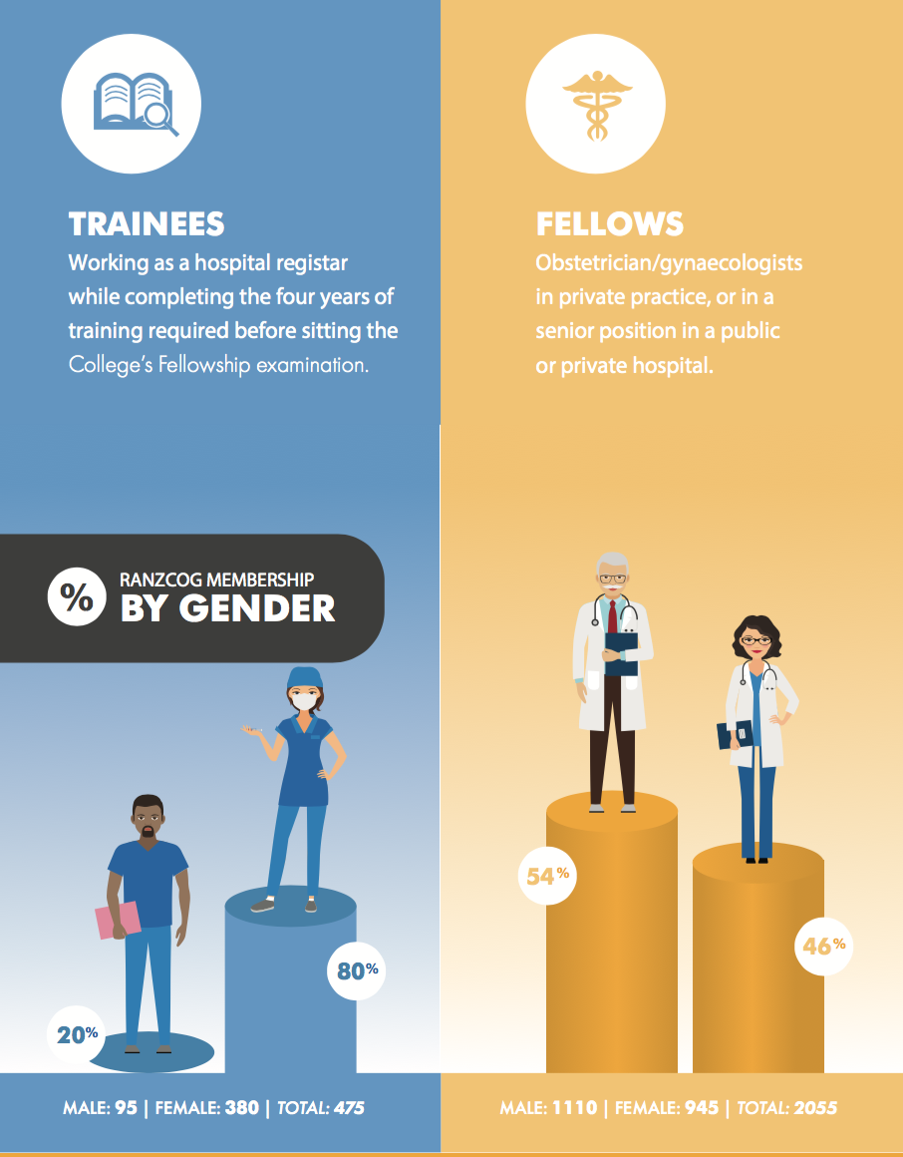
1998
Presidency - 10 terms (1 F)
Board - 7 members (1 F)
Council – 29 members (9 F)
Membership – 62% F
Trainees - >50% F for > 2 decades
Notes:
RANZCOG – training and accreditation body for obstetrician's and gynaecologist in Australia and New Zealand
Independent college since 1998
Since that time - ONLY one female president (2006-2008) – 2 year term
AND the number of females in federal council, although increasing, has never increased beyond 30%
Current national board – 7 positions – one is held by a female
This is despite being an increasingly feminized with 80% of trainees now females and 46% of specialists being female
More than 2 decades now females have been the trainee gender majority
…
Many would advocate that gender equality is highly desirable in the leadership work space for 4 main reasons
Fulfill a social justice premise
Gender leadership diversity Improved organization revenue
More authentic representation when leadership more closely mirrors membership
Political arena – gender diversity in leadership has improved maternal and child health outcome
- You can’t be what you can’t see ….!
Trainees - (67% in 2009 – now 80% in 2017)
Specialists - (27.2% in 2005 --> 46% in 2017)

Slide 5
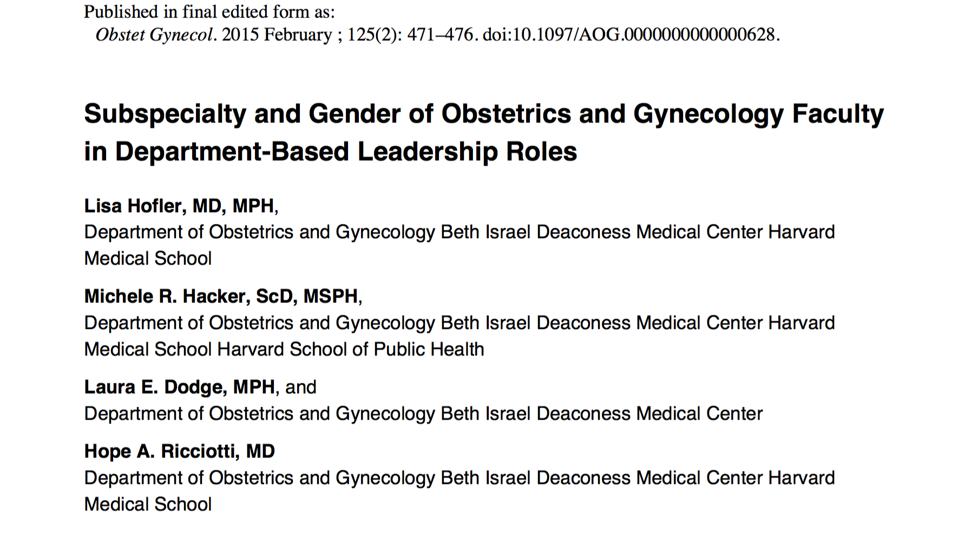
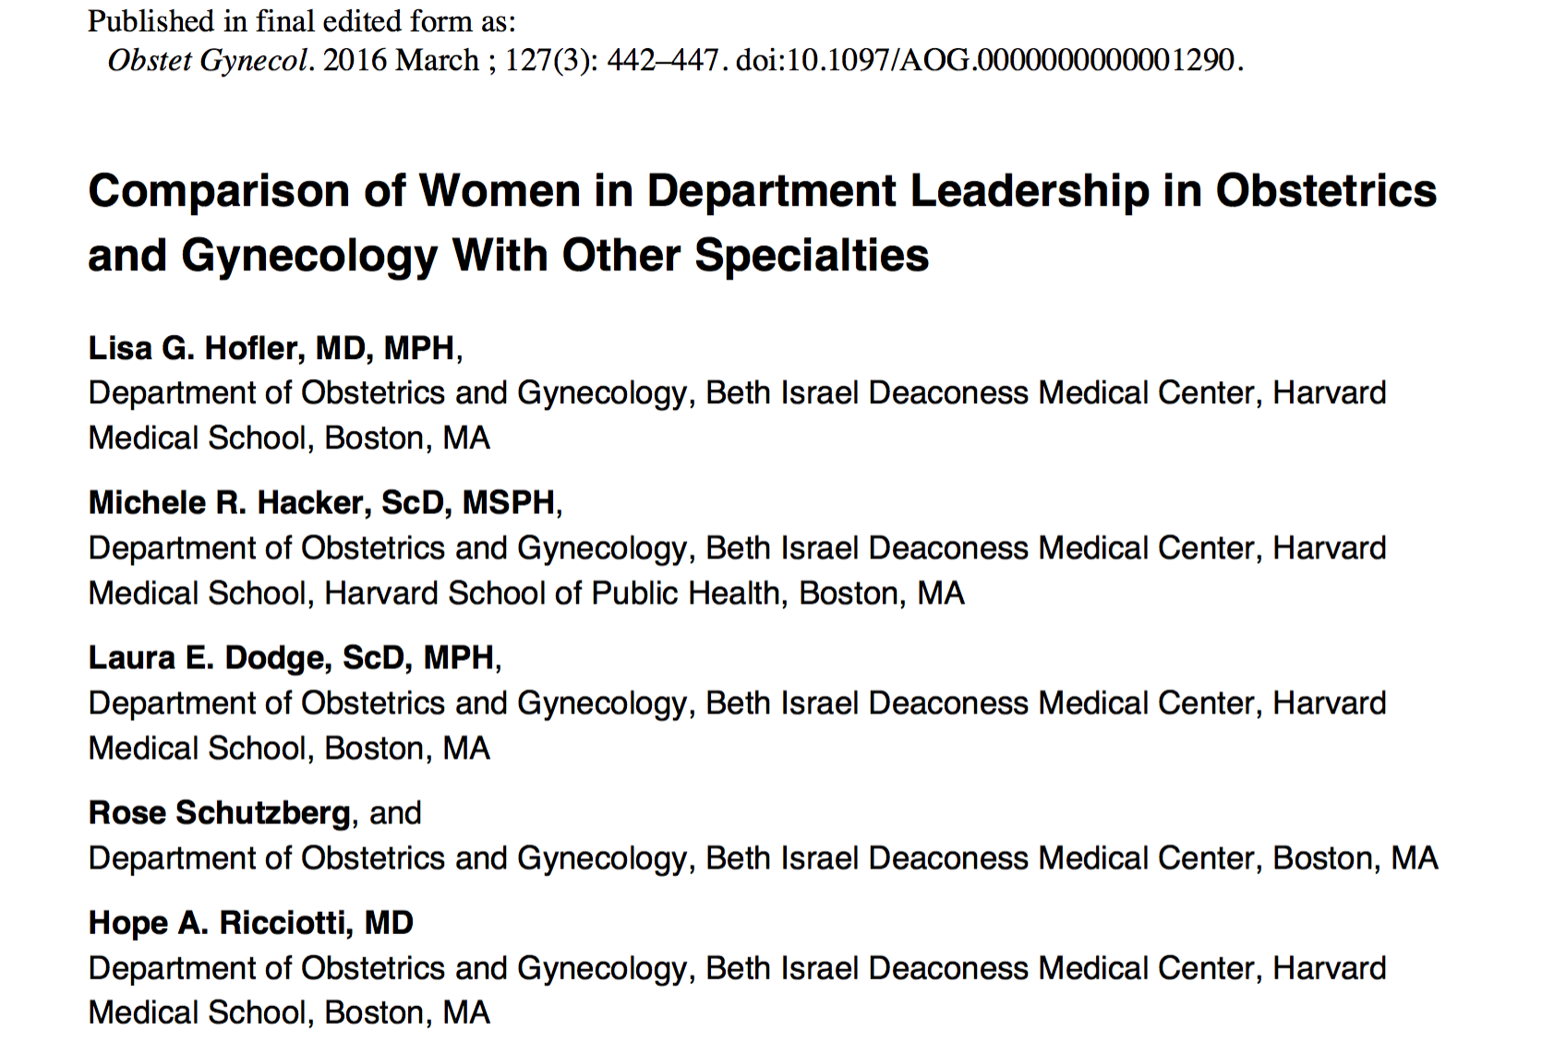
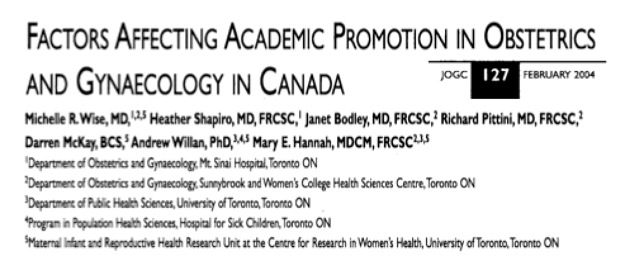
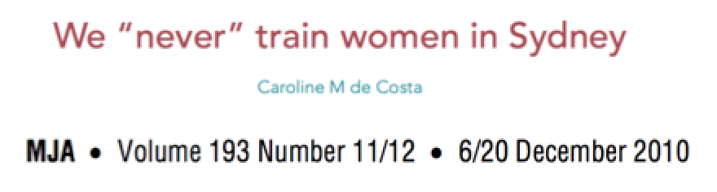
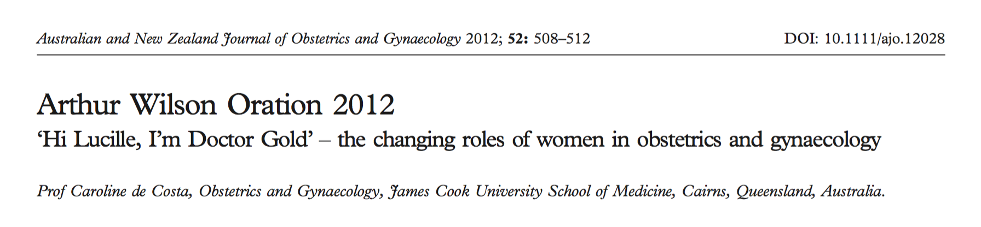
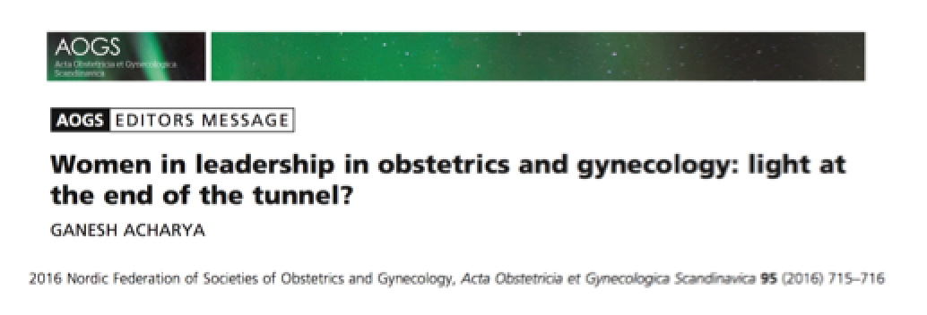
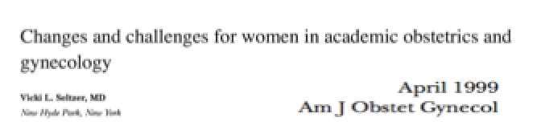
Notes:
As part of my research I reviewed the national & international literature on gender and leadership within O&G
There were seven of them!
…...
Most of my reading has come from other areas of medicine and the healthcare industry more broadly
# 1 observational study in the US accredited teaching hospitals – women were under represented in leadership positions – of the leadership positions - more likely to be in hospital teaching/supervision leadership roles, not HOD departments roles
In the US Women have comprised more than 50% of obstetrics and gynecology residency graduates for over 20 years (6)
# 3 cross sectional observation study – compared number of women in leadership roles between O&G and other specialty departments across the US
Lower compared with other specialties and lower compared to intact in residency (of women) in 1990 to now (2013) – pipeline effect – not enough
- Most recent – October 2017
# 3 Qualitative study – O&G departmental chairs at the 16 medical schools - survey on attitudes on gender and leadership and leadership promotion – 2003
1/3 females
Women more likely to perceive barriers to promotion
Mentorship

Slide 6
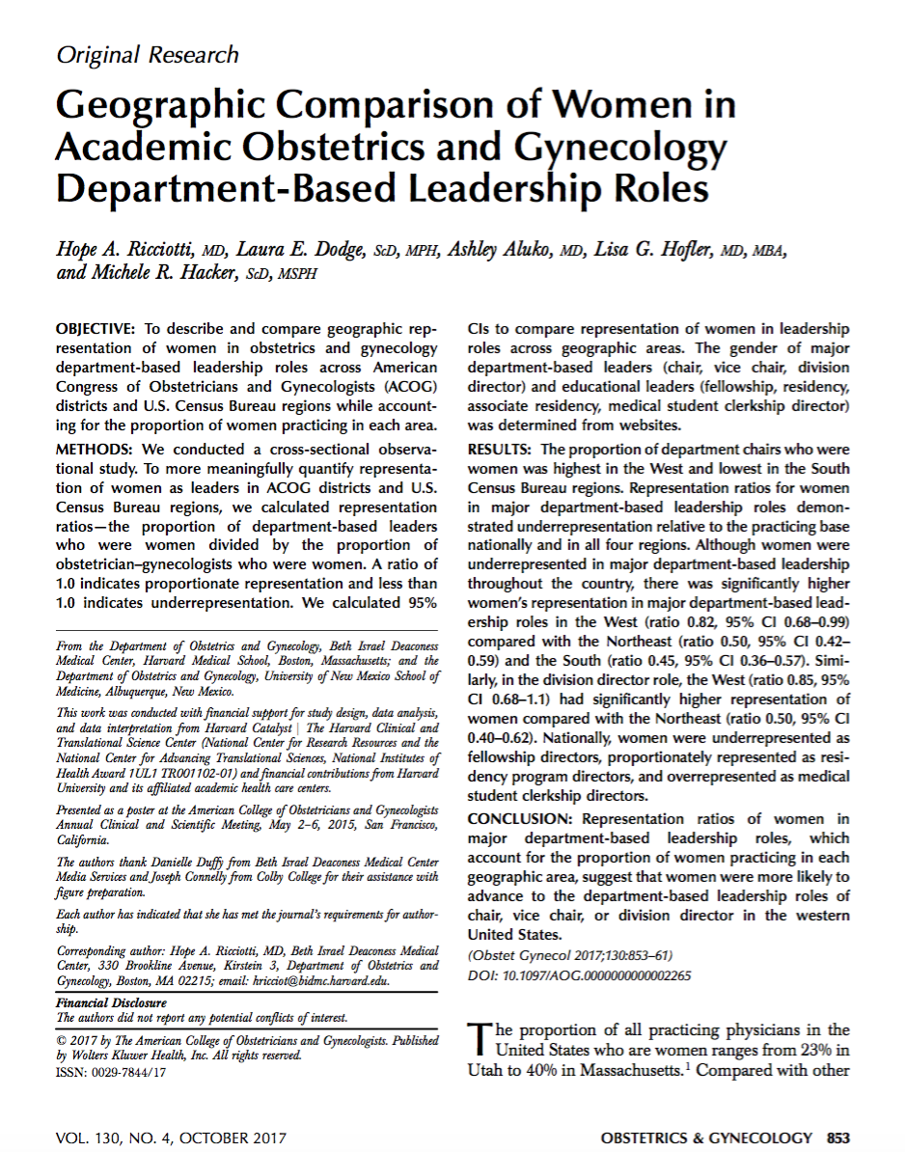

Notes:
Excitedly – 3 weeks ago – an 8th was published!
What is revealed form the literature on gender and leadership in O&G - is that women are under represented
Those that do hold leadership positions - were more likely to hold ‘educationally related leadership positions, less likely to hold head of department leadership positions - & more likely to hold a position if other women were already in similar leadership positions, and if they had received mentoring
..
TOTAL 8
FOUR observation studies - 3 US / Canada
Consistent underrepresentation of female in departmental, divisional, or high level leadership positions, appropriately represented in mid level educational leadership role, and over represented in medical student leadership
2013 – women 50% representation in practice
28% departmental leadership
? Cultural bias of women becoming teachers
Geographical influence on females in leadership
ONE qualitative studies addressing barriers to leadership from those in positions (USA)
THREE commentaries on leadership in the specialty
- Australia, US and UK
# 1 observational study in the US accredited teaching hospitals – women were under represented in leadership positions – of the leadership positions - more likely to be in hospital teaching/supervision leadership roles, not HOD departments roles
In the US Women have comprised more than 50% of obstetrics and gynecology residency graduates for over 20 years (6)
# 3 cross sectional observation study – compared number of women in leadership roles between O&G and other specialty departments across the US
Lower compared with other specialties and lower compared to intact in residency (of women) in 1990 to now (2013) – pipeline effect – not enough
- Most recent – October 2017
# 3 Qualitative study – O&G departmental chairs at the 16 medical schools - survey on attitudes on gender and leadership and leadership promotion – 2003
1/3 females
Women more likely to perceive barriers to promotion
Mentorship

Slide 7
Methodology - 1
Mixed methods (quantitative & qualitative approach)
  Snapshot of gender & leadership landscape AND members views on leadership, gender bias and gender quotas.
Access public documents
  RANZCOG, RANZCOG accredited hospitals in Australia & NZ (98 sites), and O&G university departments in Australia & NZ (18 sites)
  Institutional website (& phone directory listings)
Data analysis
  Quantitative data & descriptive statistics; chi-squared testing.
Notes:
To achieve my aims I used a mixed method approach that would gather both qualitative and quantitative data
1st step – accessing public documents at
RANZCOG, RANZCOG accredited hospitals in Australia & NZ (98 sites), and O&G university departments in Australia & NZ (18 sites)
Quantitative data was analyzed using descriptive statistics; chi-squared testing.
…
For the purpose of this research ‘gender’ refers to the identity and state of being of a person, typically (though not exclusively) understood as ‘male’ or ‘female’
The gender of those in leadership positions was determined by name and confirmed by image and pronoun use.
‘Leadership’ was defined as holding a professional ‘position of leadership’ (12, 43-45). O&G leadership positions included the RANZCOG presidency, RANZCOG national board members, RANZCOG federal councilors, RANZCOG national chairs, RANZCOG Integrated Training Program (ITP) and Training and Assessment (T&A) state chairs, RANZCOG ITP program coordinators, departmental or unit heads within O&G departments of RANZCOG accredited hospitals, as well as the departmental heads within university O&G departments in Australia and New Zealand.

Slide 8
Methodology - 2
RANZCOG membership survey
  Obtain RANZCOG ethics approval
  Online survey (survey monkey) – 2530 member - closed and open ended questions
Data analysis
  Quantitative data & descriptive statistics; chi-squared testing.
  Qualitative data – free text comments.
    Thematic analysis (Braun & Clark 2006) – inductive and semantic approach
    Repeatedly reading all responses, the generation of initial codes with categorisation of the text according to common patterns or recurring ideas, searching for themes, reviewing and refining these themes, followed by defining and naming these themes. These themes were then compared to theories and understanding about gender equality in the workplace.
Notes:
2nd step – membership wide survey to 2530 members - with both closed and open ended questions
This time both a quantitative and qualitative analysis of the data was performed, with thematic analysis the tool for analyzing the qualitative data
NEW to me and I’ve provided a description of what this involved
…

Slide 10
RANZCOG leadership positions
Notes:
1st findings
Snap shot of RANZCOG gender and leadership
Gender leadership gap is present at a national level, with more matched representation within state based & hospital educational leadership roles
….
RANZCOG president (2 year terms – 1998 – only one female president) = 0%
0% / 100%
RANZCOG federal board – 7 members – 1 female = 14%
RANZCOG federal council – 22 members – 7 females = 32%
National Chairs – 62 – 19 females - 31%
Educational
State T&A Chairs 7 members – 5 females – 71%
Hospital ITP program coordinators – 32 total – 17 females - 53%

Slide 11
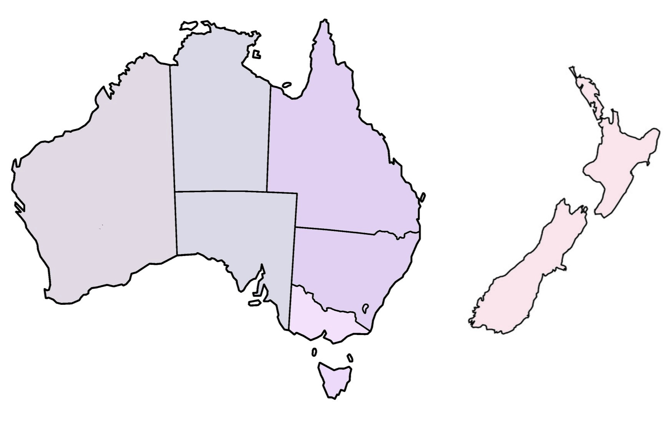
Accredited hospitals HOD
27%
21%
16%
27%
58%
33%
38%
33%
Notes:
Within hospital O&G departmental leadership roles – an underrepresentation of females in leadership roles – except NZ
….
State by state – hospital HOD/Units - Total = 31.5% (average) -
VIC 37.5% - 22 hospitals
TAS 33.3% - 3 hospitals
ACT 33.3% - 3 hospitals
NSW 27.3% - 25 hospitals
QLD 26.7% - 16 hospitals
WA 21% - 8 hospitals
SA/NT 16% - 9 hospitals
NZ 57.7% - 12 hospitals
New Zealand – north Island – 72% female
- south island – 25% female
Within Australia, Westmead hospital is notable as an outlier with 80% female leadership.
Amongst tertiary hospitals, Royal Prince Alfred Camperdown, Women’s and Children Adelaide, and the Gold Coast University hospital, have no females in leadership positions.
Interesting a smaller percentage of responders (21%) currently hold leadership position in New Zealand, compared with Australian responders (33%). Both countries, New Zealand and Australia, had matched levels of desire for future/additional leadership (34% and 35% respectively), and free text comments on leaderships eluded to barriers within leadership with equal proportion (62% and 61% respectively), and type.

Slide 12
University O&G
Department Head
Australia 33%
18 Universities
20 Heads of department
5 females (2 joint)
New Zealand 67%
2 Universities
3 Heads of department
2 females (1 joint)
Notes:
Similar finding of the gender leadership gap was found within University O&G departmental leadership roles
….
Head of the discipline O&G
TOTAL 30.5%

Slide 13
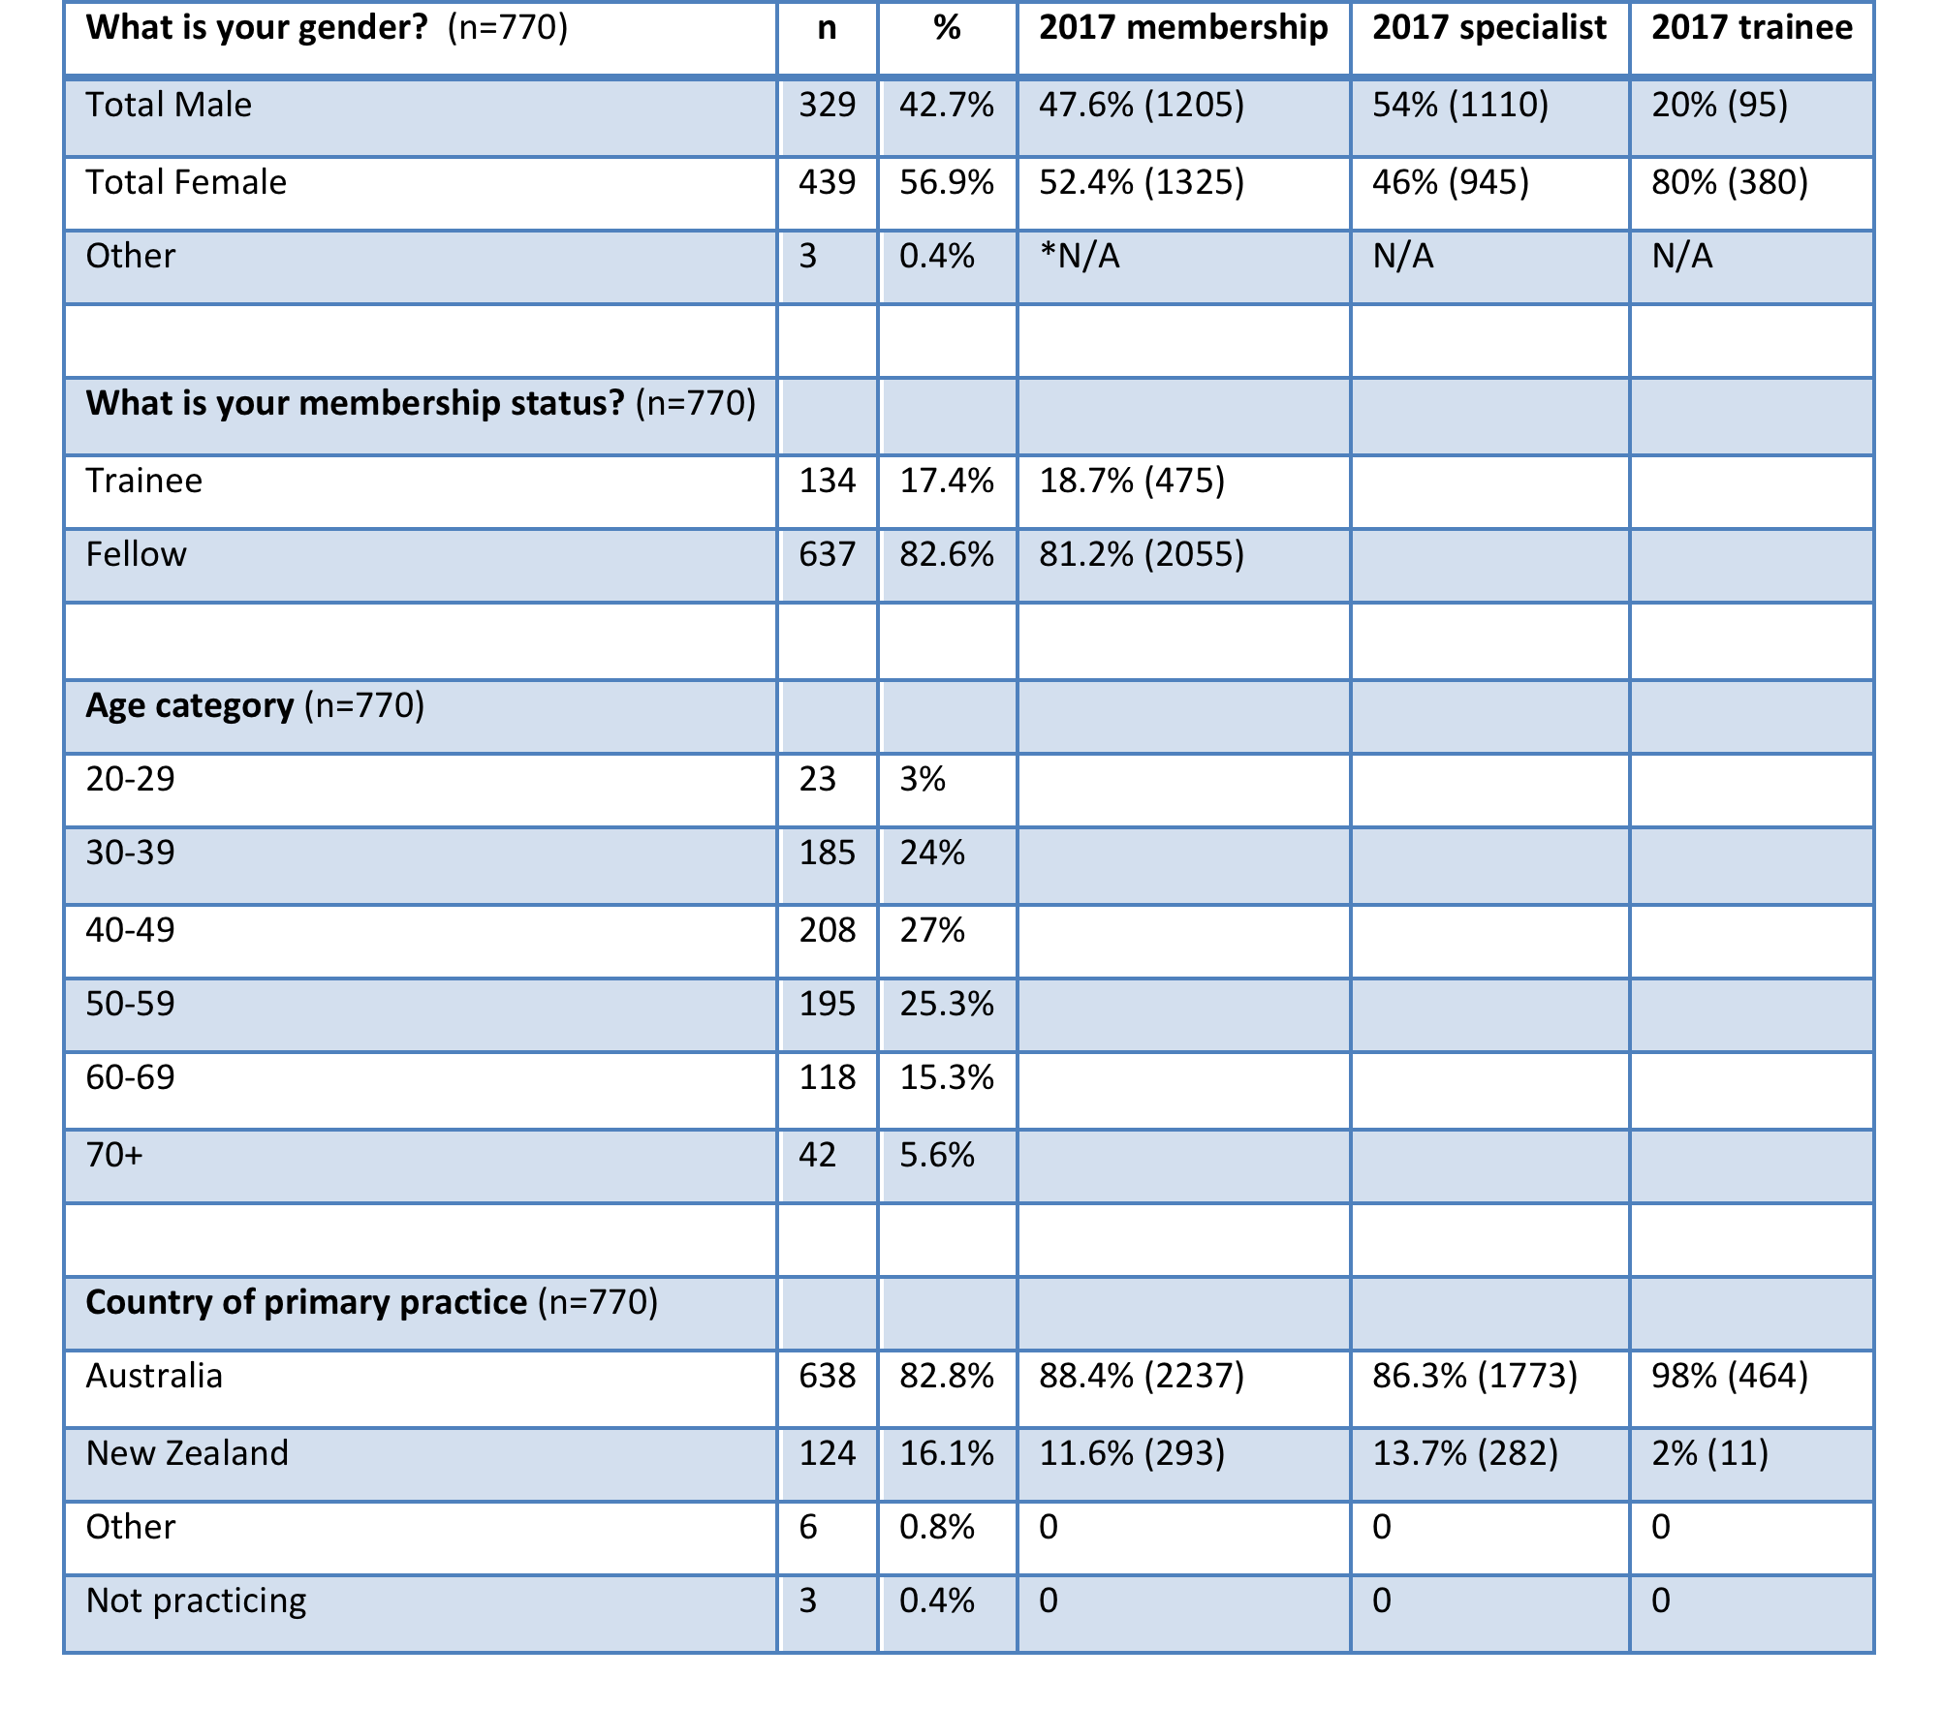
30% Response Rate (770)
Notes:
With distribution to all 2530members, a 30% responses rate was obtained
This table reveals the demographics from my membership survey
Not perfectly sample – slight overrepresentation of female responders but does show a proportionate representation of trainee and specialists responders
….
The responder sample is however not perfectly representative of RANZCOG membership gender, with a statistically significant greater proportion of female responders than RANZCOG female members (p=0.0079).

Slide 14
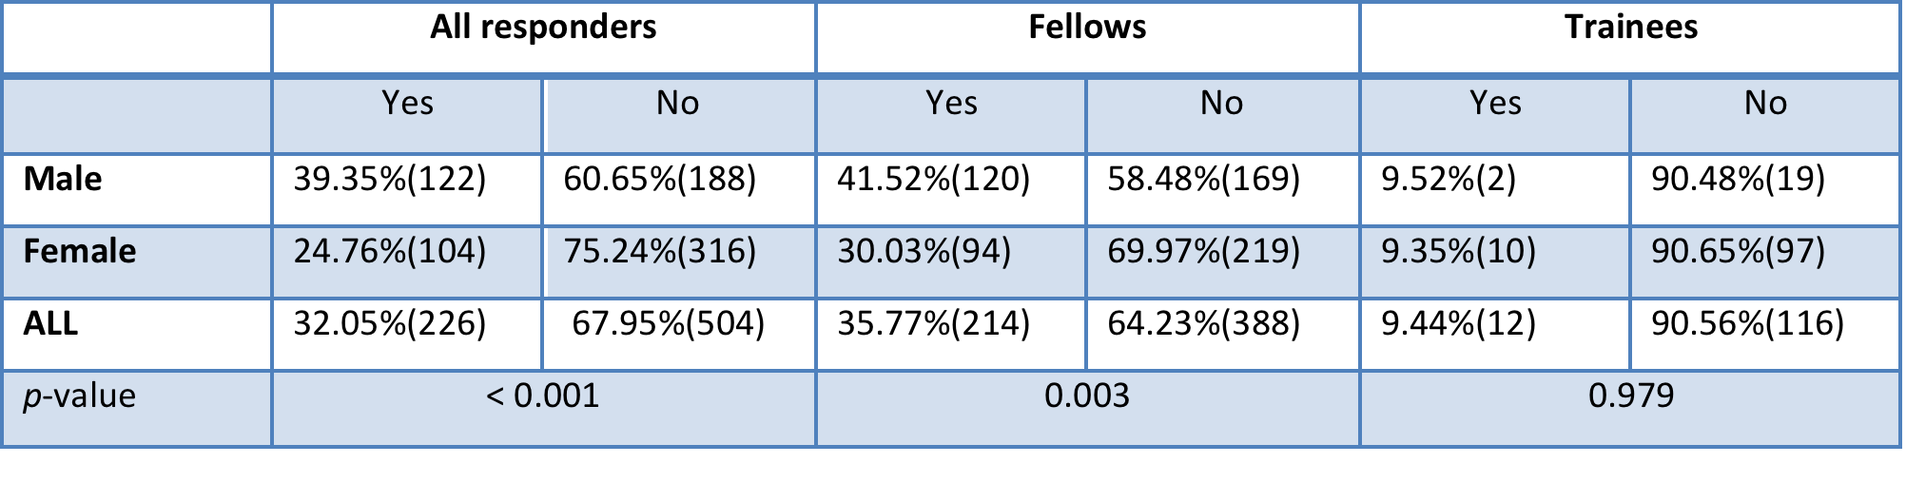
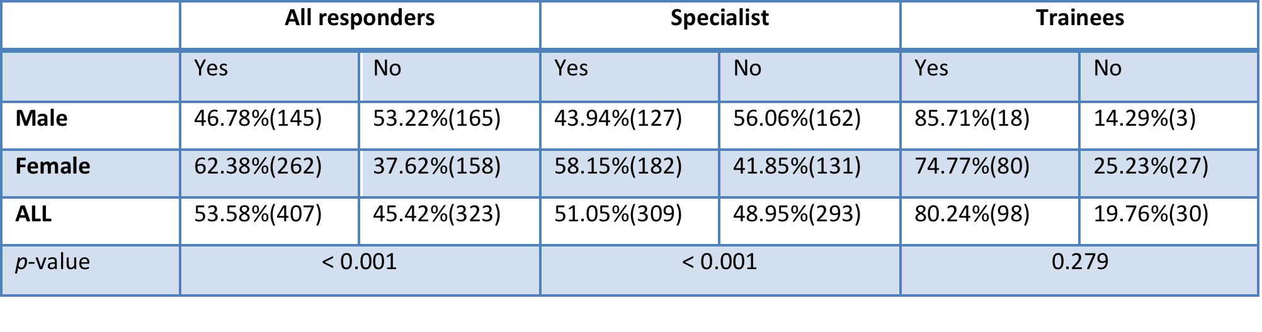
Leadership
Do you currently hold a leadership positions within RANZCOG, University or your hospital?
Would you like to hold an additional leadership position now or in the future?
Notes:
Within the section of leadership - female responders reported lower rates of leadership with all institutions, but desired higher levels of leadership

Slide 15
Leadership
What factors stop you from seeking a leadership position or additional leadership positions?
Notes:
From the 8 listed barriers to leadership, females responders ranked all higher than male responder - except for lack of interest
With the most chosen amongst males and females being available time, family commitments and personal energy

Slide 16
Leadership
Thematic analysis: Any comments regarding O&G leadership?
20% response rate
MAJOR THEME - Leadership barriers
- 83% of female responders
- 60% of male responders
- 85% of trainee responders
Sub-themes
  Females – disillusionment, time & financial barriers, gender barriers, ‘learning leadership’.
  Males – disillusionment, time & financial barriers, ‘learning leadership’, ‘changing of the guard’.
“RANZCOG leadership seems most interested in their own views and their colleagues pockets, not what is best for women. Also no respect for views of members” (F, 50+, Australia)
“RANZCOG has elections that have a set pattern of ascendancy in a rigid old boys network that prevents other from outside joining and progressing through the ranks” (M, 40+, Australia)
Notes:
Within free text responses on O&G leadership, the dominant theme was that of ‘leadership barriers’
With this theme were the sub-themes of disillusionment, time & financial barriers, gender barriers, ‘learning leadership’ amongst female responders
AND
- disillusionment, time & financial barriers, ‘learning leadership’, ‘changing of the guard’ amongst male responders
….
FEMALES
Within this theme of ‘leadership barriers’, subthemes of ‘disillusionment’ (40% of responses), ‘financial and time’ barriers (27% of responses), and ‘gender barriers’ (22% of responses), and ‘learning leadership’ (13% of responses), were present.
MALES
Within this theme ‘barriers to leadership’, the subthemes of ‘disillusionment’ (60%) ,‘financial and time barriers’ (22% of responses), and ‘learning leadership’ (19%) predominated. No male responders commented on ‘gender bias’ as a barrier to leadership.
‘RANZCOG leadership seems most interested in their own views and their colleagues pockets, not what is best for women. Also no respect for views of members’ (F, 50+, Australia) and ‘very large time commitment involved in RANZCOG leadership, which incurs opportunity cost (lost income from paid work) or impacts on family time’ (F, 40+, Australia)
‘RANZCOG has elections that have a set pattern of ascendancy in a rigid old boys network that prevents other from outside joining and progressing through the ranks’ (M, 40+, Australia) and ‘under paid and under appreciated’ (M, 60+, Australia)

Slide 17
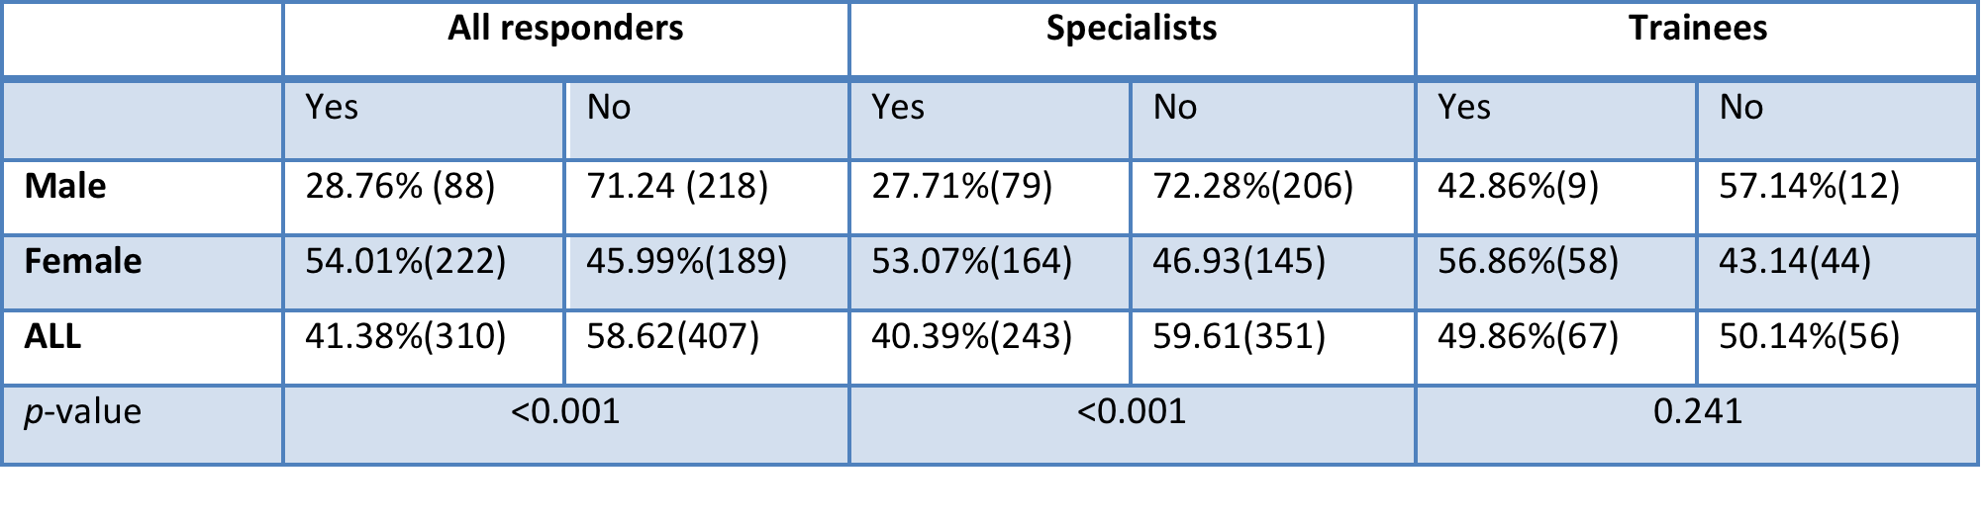
Gender Bias
Have you experienced gender bias during your training or specialist years?
Notes:
Gender bias was reported by 58% of responders, with a SS higher rate among female responders

Slide 18
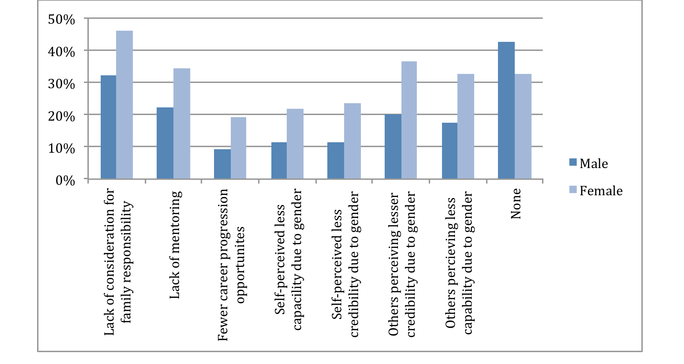
Gender Bias
What gender biases, if any, do you believe exist for trainees and specialists that limit leadership opportunities?
Notes:
Lack of consideration for family, lack of mentoring, and others perceiving less capability due to gender – were ranked as the top 3 barriers for female responders with regards to gender bias
‘NONE’ to gender bias ranked as the top barrier for male responders

Slide 19
Gender bias
Thematic analysis: Any comments regarding gender bias?
20% response rate
MAJOR THEME – ‘gender bias is present’
- Females – ‘gender bias is present’ (57%)
- Males – ‘male gender is present’ (42%)
Sub-themes
  Females – ‘less capable surgically’ and ‘pregnancy & parenting’
  Males – ‘our specialty risks male discrimination ’
“There are lesser credentialed men getting positions of leadership and career pathways mapped out for them on the basis of nepotism old school networks and gender bias all the time’ (F, 40+, Australia) and ‘didn't’ find this to be an issue until I started being seriously interested in complex gynae surgery. Then came across perceptions about how I would not be as good after I had kids” (F, 30+, New Zealand)
“With less men in the workforce I see more bias to men than the opposite traditional gender bias of previous years” (M, 60+, overseas)
Notes:
Within free text responses on gender bias, the dominant theme was ‘gender bias is present’
Within this were the sub-themes of ‘less capable surgically’ and ‘pregnancy & parenting’ amongst female responders
AND
- ‘ ‘our specialty risks male discrimination’ amongst male responders
…..
FEMALES
‘female gender bias is present’ (57%). Fourteen percent (14%) of responders indicated they did not believe gender bias existed, either in their own setting (33.3%) or in the broader speciality (66.6%).
MALES
Eighteen percent (18%) of responders indicated that they did not believe gender bias existed.
‘There are lesser credentialed men getting positions of leadership and career pathways mapped out for them on the basis of nepotism old school networks and gender bias all the time’ (F, 40+, Australia) and ‘didn't’ find this to be an issue until I started being seriously interested in complex gynae surgery. Then came across perceptions about how I would not be as good after I had kids’(F, 30+, New Zealand)
With less men in the workforce I see more bias to men than the opposite traditional gender bias of previous years’ (M, 60+, overseas) and ‘as a male, many patients choose not to or complain about seeing me’ (M, 40+, Australia)

Slide 20
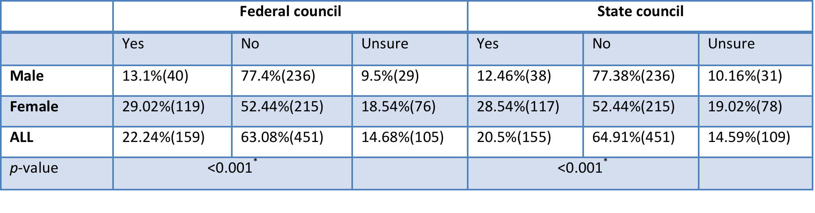
Gender quotas
Should RANZCOG consider a gender quota system for federal council & state councils?
*’No’ and ‘Unsure’ were combined to indicate ‘Not Yes’ in the statistical analysis.
Statistical significance remained when comparing ‘Yes’ and ‘No’ and ‘Yes’ and ‘Not Yes’
Notes:
Overall responders were not in favor of gender quota use, with males holding higher levels of opposition compared to female responders

Slide 21
Gender quotas
Thematic analysis: Any comments regarding gender quota use?
33% response rate
  63% were opposed to quota use
MAJOR THEME – ‘Best person for the job’
- 83% of female responders
- 71% of male responders
- 95% of female trainee responders
Sub-theme
  Females – Merit (66%), ‘the pipeline’ (12%)
  Males – Merit (48%) and ‘the pipeline’ (23%)
“The most qualified or suitable person should get the position, irrespective of gender, race or colour” (F, 40+, Australia) AND “The playing field at the top end is not level. Quotas as a transitional tool can help RANZCOG achieve leadership equity. Once leadership is equitable, then can be slowly tapered off” (F, 50+, Australia),
“The most capable people ought be representing us, regardless of gender” (M, 50+, New Zealand)
Notes:
Within the free text responses on gender quotas, the dominant theme was ‘best person for the job’
With sub-themes of ‘merit and the pipeline present for both’ female & male responders
** Within gender these free text response – CONTEXT played an extremely important role
20% of those opposed to quotas use acknowledging their lack of awareness of current gender leadership status or knowledge on gender barriers – if present then maybe this should be considered.
Others acknowledged their concern that in the context of low male numbers, it may well need consideration in the future with a minimum number of positions for males within national committees
….
Females – Merit (66%), ‘the pipeline’ (12%)
Males – Merit (48%) and ‘the pipeline’ (23%)

Slide 22
Findings
Leadership gender in O&G is poorly representative of both trainees and specialist, except in RANZCOG educational leadership roles
Females within RANZCOG report;
  Lower levels of leadership
  Higher levels of desire to leadership,
  Higher levels of barriers (within the closed question of 8 responses)
  Higher levels of gender bias
Gender quotas provide one solution to the gender leadership gap but were not supported by the majority of survey responders
The following statements reflect the dominant themes within the free text responses
  “Many barriers limit leadership opportunities”
  “Female and male gender bias is present in O&G”
  “Merit should drive leadership opportunities”
Notes:
This research highlights the gender leadership gap in O&G institutions in Australia and NZ
The survey revealed female responders hold higher level of desire for leadership, report higher levels of barriers & have experience higher levels of gender bias, but currently hold lower levels of leadership
THE STATEMENTS -
“Many barriers limit leadership opportunities”
“Female and male gender bias is present in O&G”
“Merit should drive leadership opportunities”
Reflected the dominant themes from this research …

Slide 23
Discussion
Why gender leadership equality?
  Social justice
  Improvements in organisational reputation & revenue
  Authenticity with membership representation
  Diversity in leadership / feminist leadership
  ‘You can be what you can’t see’
The Australian & New Zealand O&G leadership landscape is similar to that found within the International literature on O&G leadership in the USA.
  Women are desiring of leadership but lower levels obtained
  Women are more likely to achieve educational leadership roles
  The leadership pathways aren’t transparent
  Barriers exist for all, but greater for women
Notes:
There are many reasons why I believe RANZCOG and my specialty should seek gender equality in leadership
These include
-
And this study’s findings about the O&G gender leadership gap are similar to those reported in the international literature
…

Slide 24
Conclusion
RANZCOG and O&G is not unique in its gender leadership gap
  ‘Pipeline’ not the primary barrier
  Suggests wider societal cultural barriers to gender leadership as well as institutional, and individual gender biases
Study highlights areas that RANZCOG could focus ‘solutions’ towards when considering ‘leadership diversity’.
Future opportunities:
  What makes New Zealand’s North Island hospital’s context unique?
  What facilitated the leadership journey for RANZCOG’s one female president?
  What solutions are applicable to RANZOG and the O&G community to ensure leadership equality exists?
Thank you!
Notes:
Clearly the ‘pipeline’ within O&G in Australia and NZ is not the primary barrier to gender leadership equality, and this suggests consideration of the wider barriers to gender leadership equality which will likely include
wider societal cultural views and gender biases
institutional cultural and gender biases
professional organisational cultural and gender biases
as well as individual gender biases
Study highlights areas that RANZCOG could focus ‘solutions’ towards when considering ‘leadership diversity’.
- This research has highlighted lots of area for future study, and further consideration of RANZCOG’s organization and members cultural; views of gender and leadership provide one avenue for further consideration
Thank you!
The culture of the participants in medical education processes
The culture of the different organisations involved
The culture of the profession of medicine
The societal cultures within which and in relation to which medical education takes place

